Slide 1
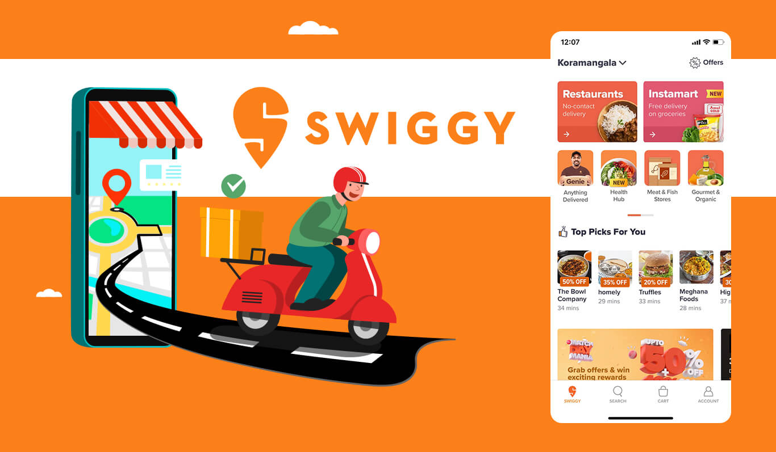
SWIGGY DATA ANALYSIS
Presented By:
Anish Katoch

Slide 2
Why This Project?
We have observed a trend towards remote kitchens in recent times, and as a data analyst, my task is to identify the best location for a remote kitchen based on the demand for different types of cuisines in the area. Our objective is to maximize customer satisfaction by providing high-demand cuisines while minimizing delivery time and costs.

Slide 3
Objectives
Scraped and analyze data from Swiggy website and presented in tables with specified details of columns.
Identify the most popular cuisines, as well as the geographic and demographic characteristics of the target area, based on a combination of customer demand, delivery time/cost, and other factors using historical order data
Found insights and created visualizations/Dashboard from the data.

Slide 4
INSIGHTS

Slide 5
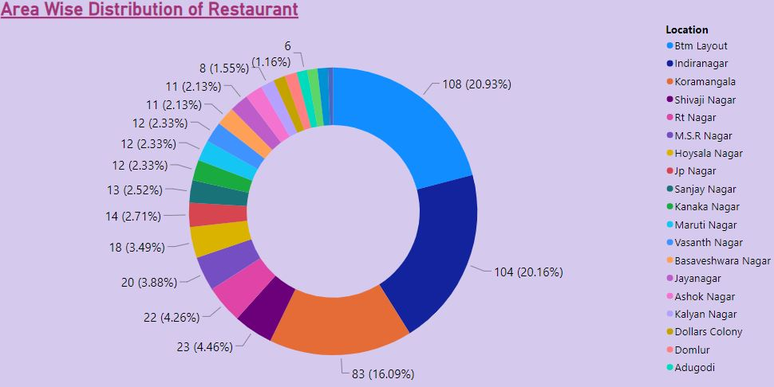
Area Wise Distribution of Restaurant
Maximum Restaurant Occupancy in Bangalore.
Indiranagar 20.16%
Btm Layout 20.93%
Koramangala 16.09%

Slide 6
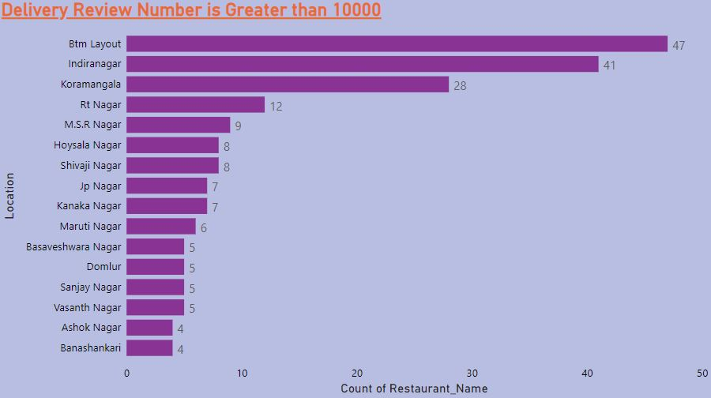
Delivery Review Number Is Greater Than 1000

Slide 7
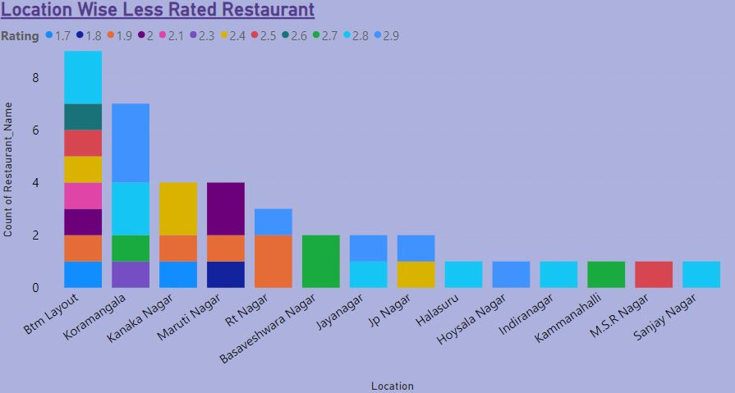
Location Wise Less Rated Restaurant

Slide 8
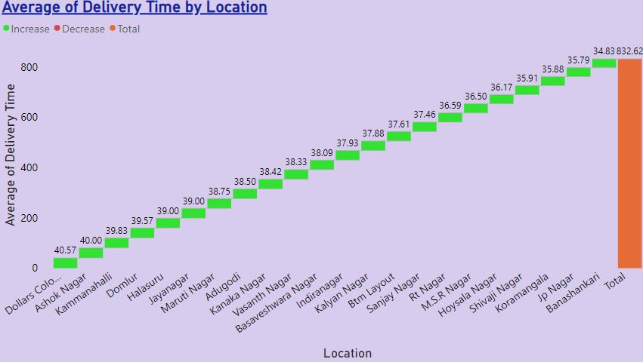
Average of Delivery Time by Location

Slide 9
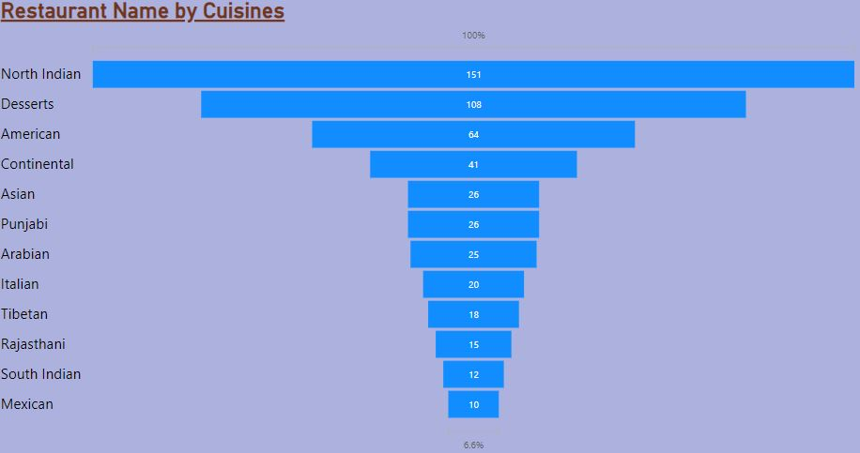
Number of Restaurant For Each Of Cuisine

Slide 10
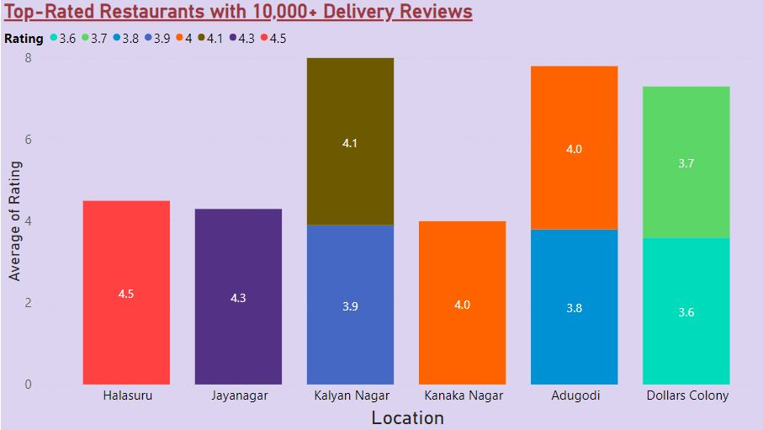
Best Location To Open a Restaurant
The best location to open a restaurant is Dollars Colony due to its great delivery views and also has the lowest average ratings.
High delivery views means there are more people in this area, and the total number of restaurants is also not high.

Slide 11
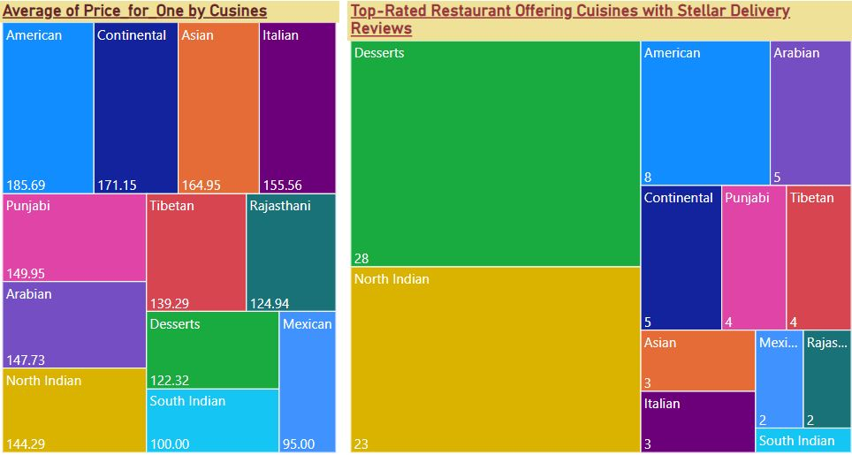
Cuisines
We have selected several cuisines to be available in our restaurant, including Deserts for 122 rupees, American for 185 rupees, North Indian for 145 rupees, and Arabian for 150 rupees. The average price for our menu items is competitive and designed to cater to a variety of tastes and budgets.

Slide 12
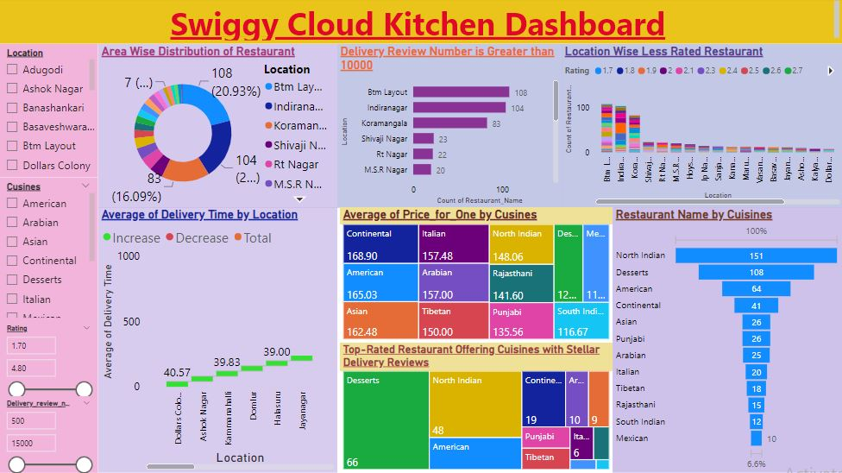

Slide 13

Challenges
Unable to scrape Swiggy data due to dynamic site.
Complex HTML.
Need to manage time efficiently.

Slide 14

Learning
Web scraping.
Basic understanding of HTML Script.
New Python library like Selenium and BeautifulSoup.
Effective teamwork and time management strategies.

Slide 15
THANK YOU

